Slide 1

The Maths of Predators and Preys Don’t get Eaten by the Wolf
Dr John Butler TU Dublin (Lecturer in Mathematics and Statistics)

Slide 2
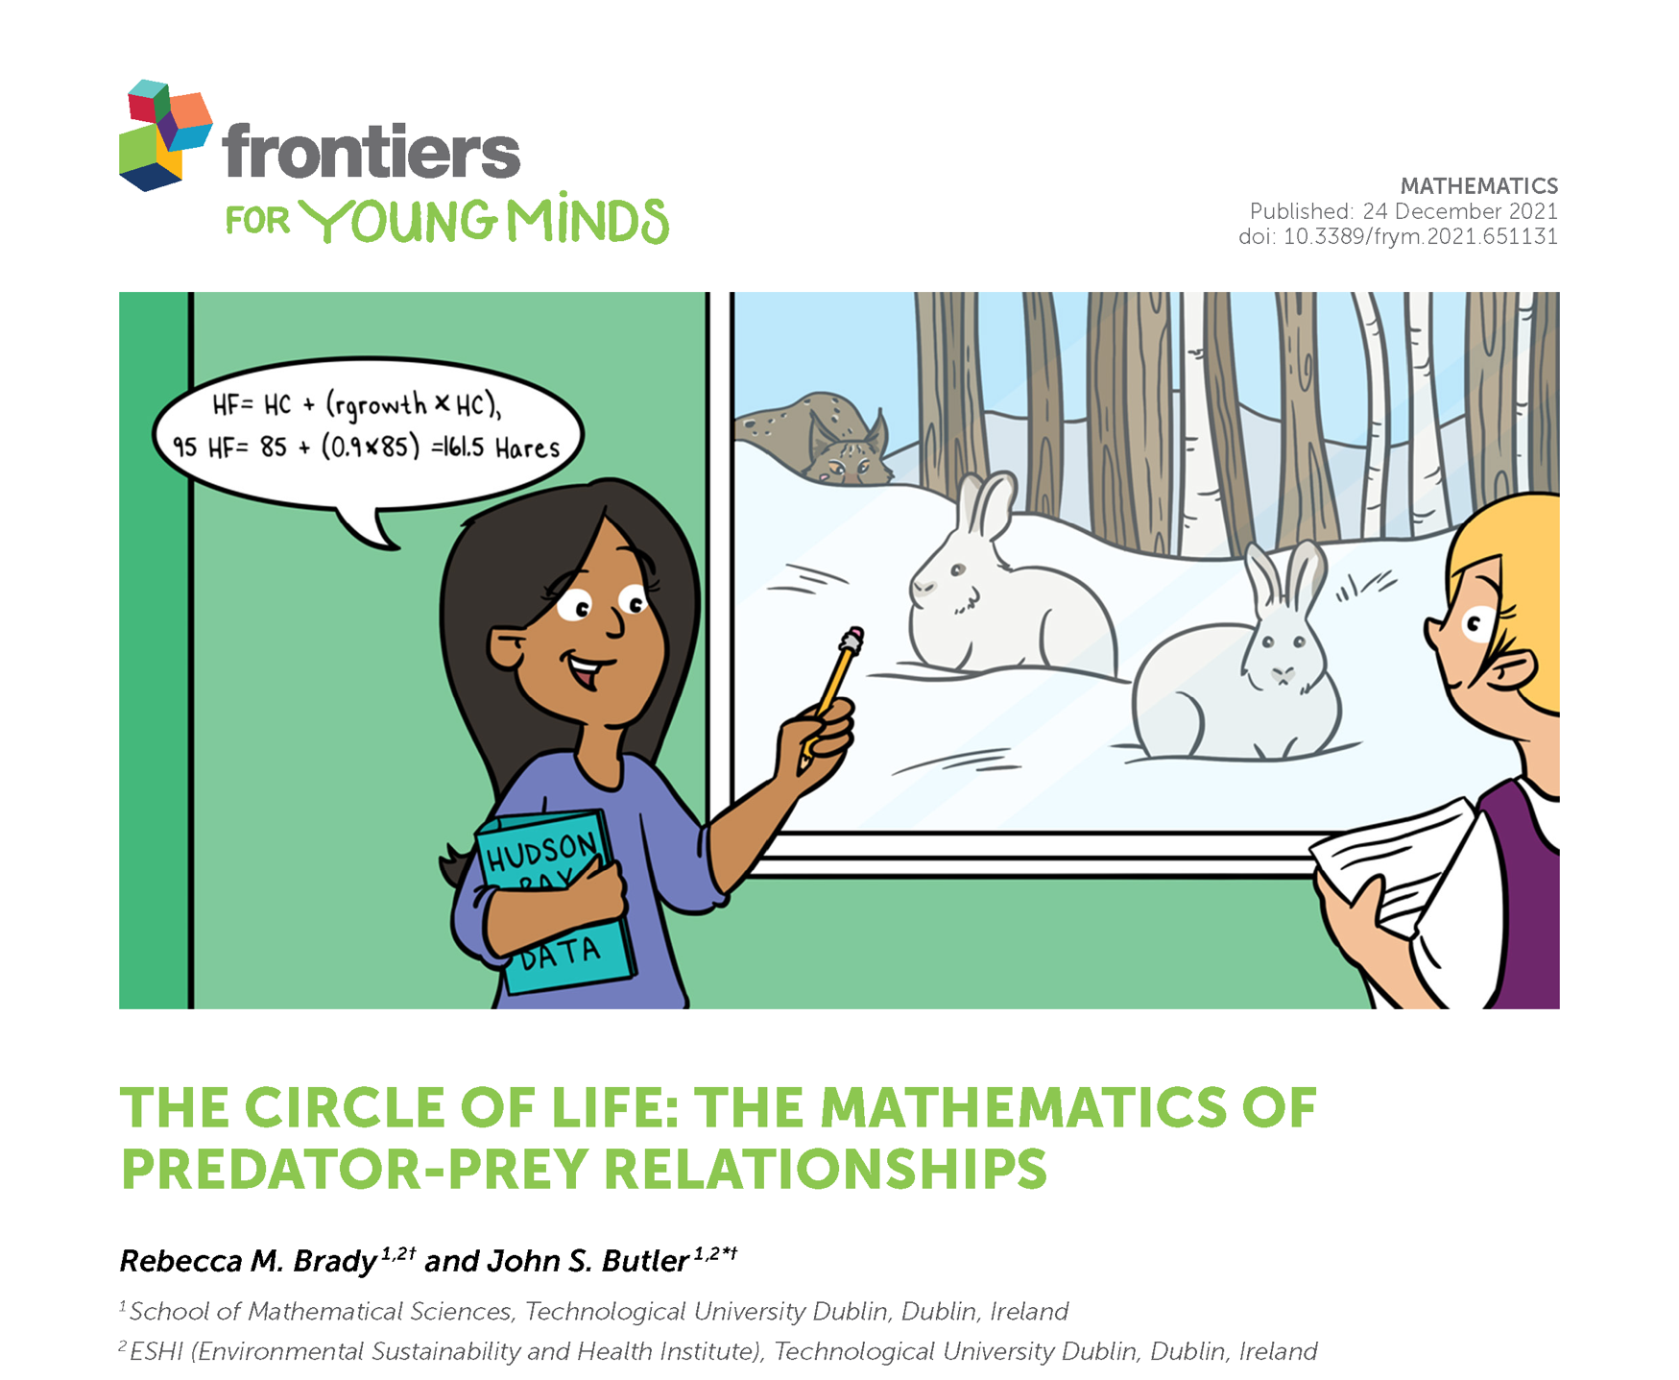

Slide 3
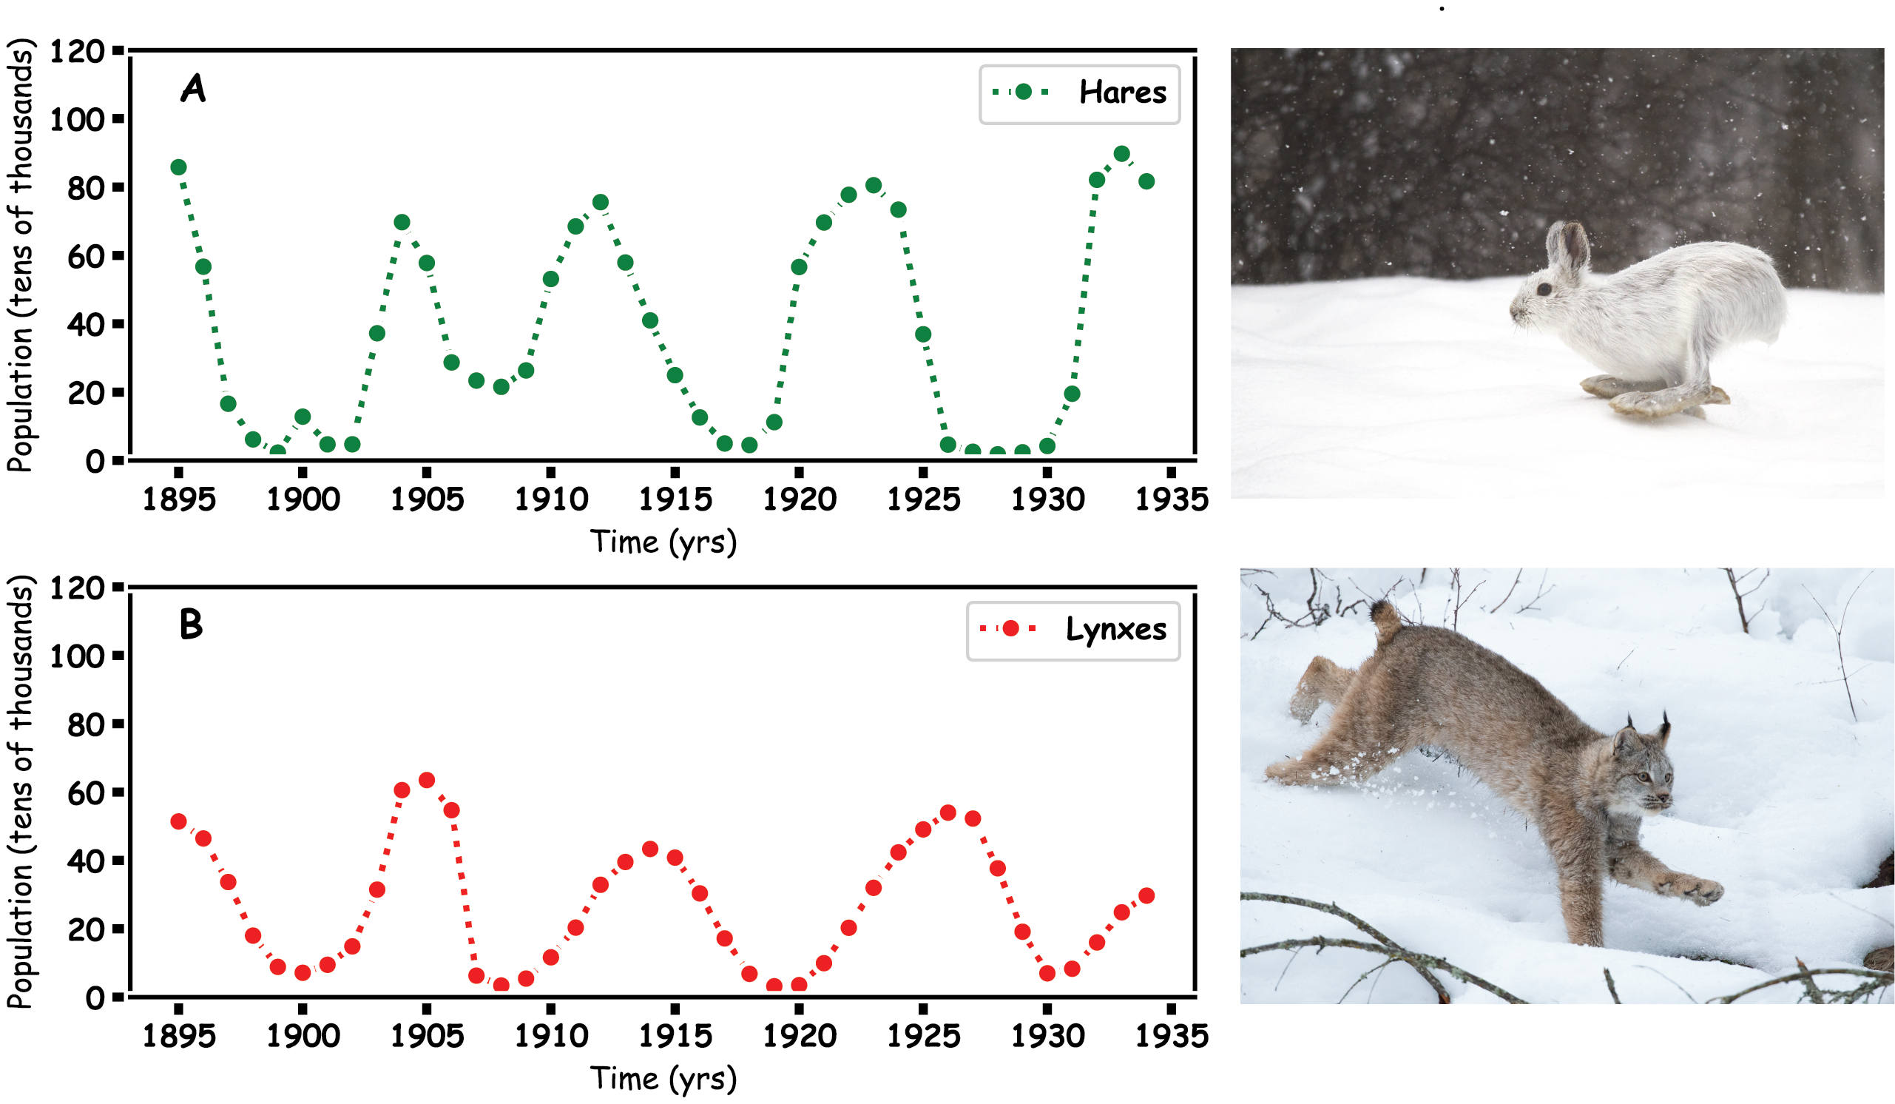
Predator Prey
Hares and Lynx

Slide 4
Prey Hares

Slide 5
Predator

Slide 6
Predator and Prey

Slide 7
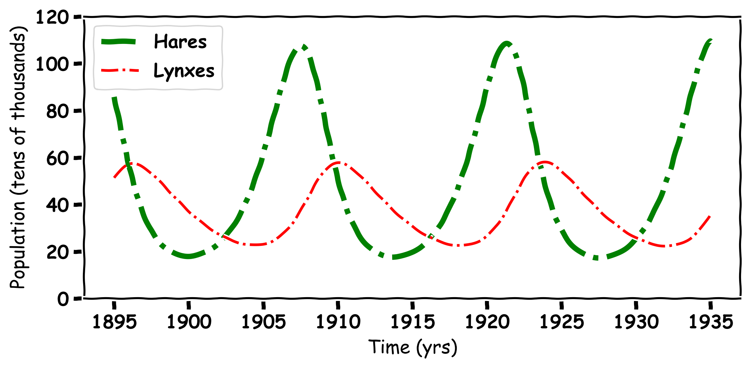
Predator and Prey

Slide 8
Mathematics

Slide 9
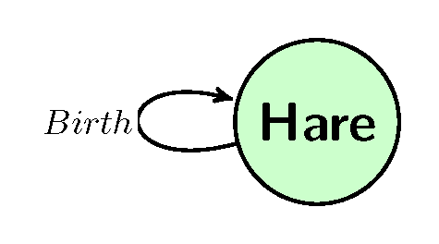

Hares
How to we make a model for a Hare population

Slide 10
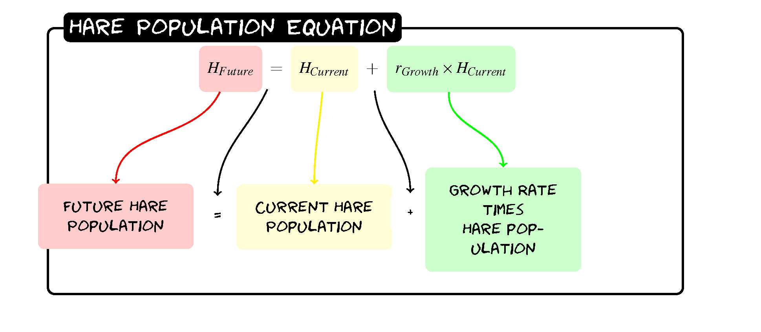
Hares
H_{Future}=H+0.2(H)

Slide 11
Hares
H_{Future}=H+0.2(H)
Year | Hare Population
0 | 60
1
2
3

Slide 12
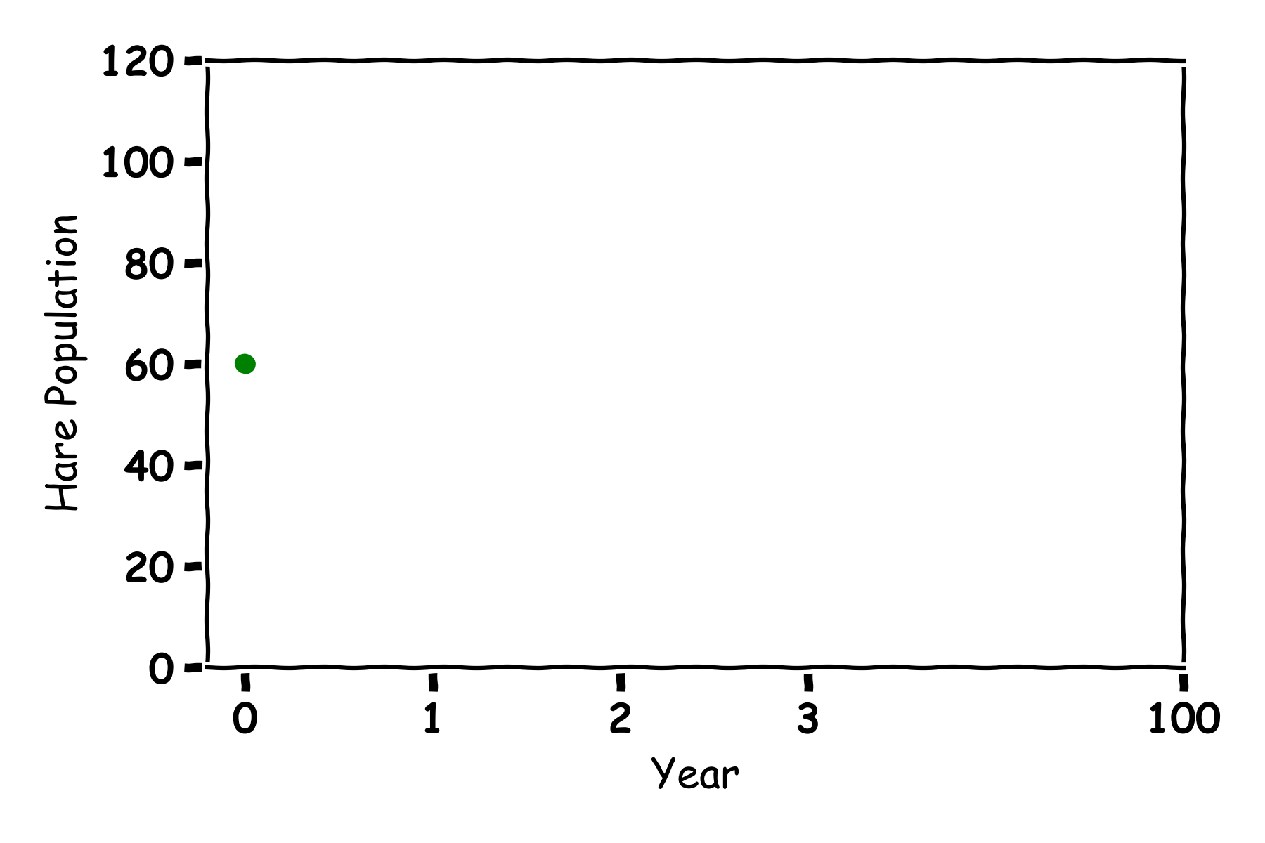
Hares
H_{Future}=H+0.2(H)
Year | Hare Population
0 | 60
1 | 60+0.2(60)=72
2
3

Slide 13
Hares
H_{Future}=H+0.2(H)
Year | Hare Population
0 | 60
1 | 60+0.2(60)=72
2 | 72+0.2(72)=86
3

Slide 14
Hares
H_{Future}=H+0.2(H)
Year | Hare Population
0 | 60
1 | 60+0.2(60)=72
2 | 72+0.2(72)=86
3 | 86+0.2(86)=103

Slide 15
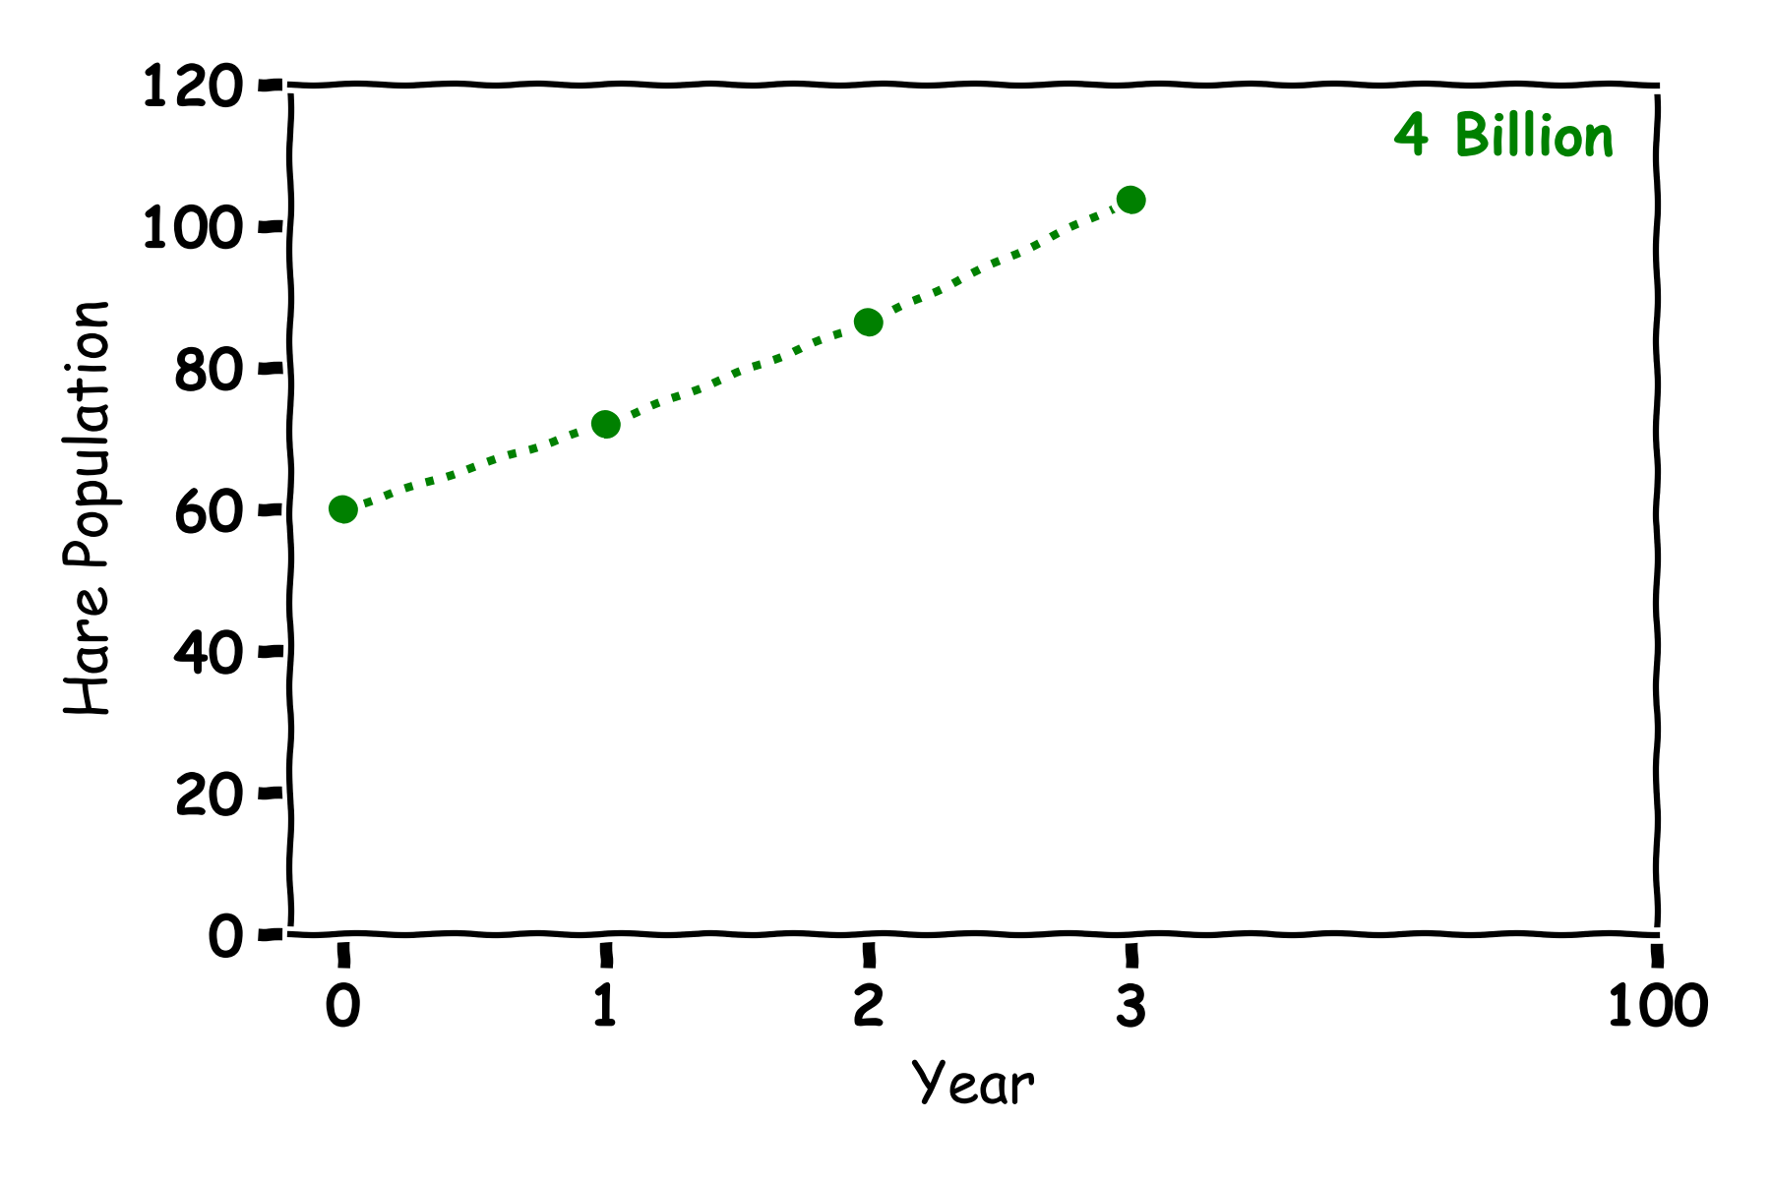
Hares
Year | Hare Population
0 | 60
1 | 72
2 | 86
3 | 103

Slide 16
Hares
Year | Hare Population
0 | 60
1 | 72
2 | 86
3 | 103

Slide 17
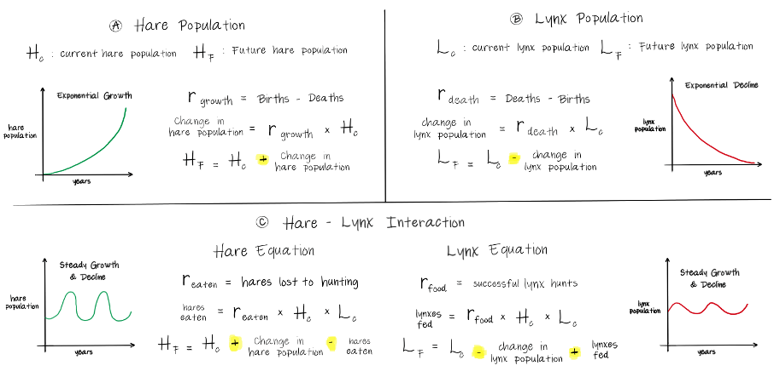
Hare Population

Slide 18
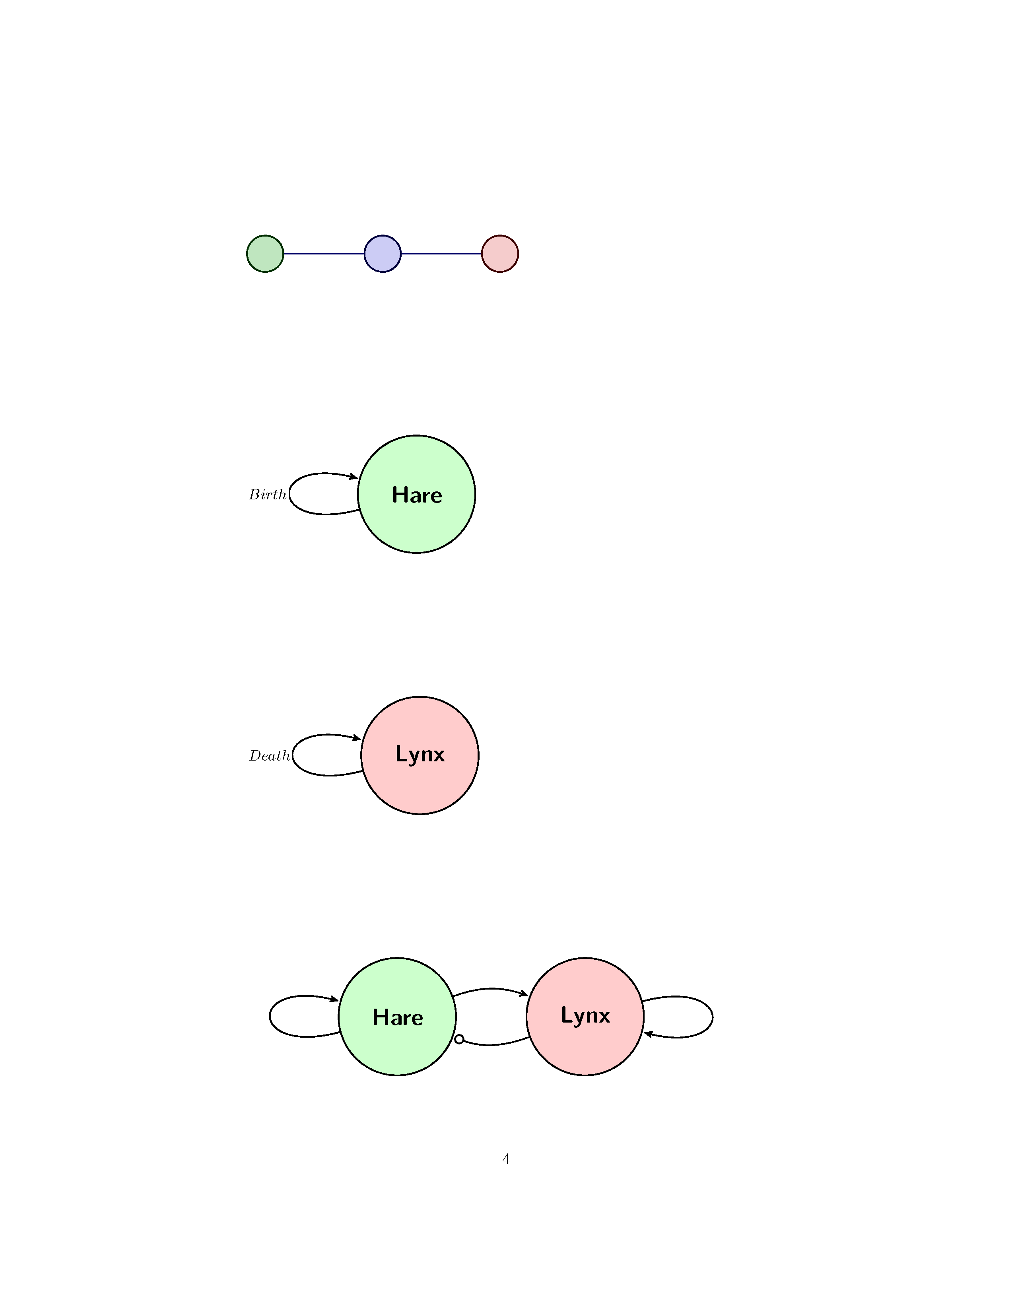
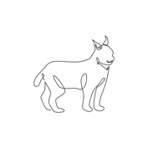
Lynx
How to we make a model for a Lynx population

Slide 19

Lynx
L_{Future}= L-0.1(L)

Slide 20
Lynx
Year | Lynx Population
0 | 30
1
2
3

Slide 21
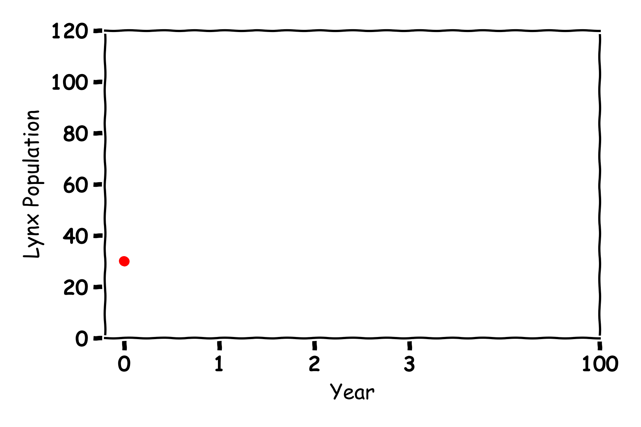
Lynx
L_{Future}= L-0.1(L)
Year | Lynx Population
0 | 30
1
2
3

Slide 22
Lynx
L_{Future}= L-0.1(L)
Year | Lynx Population
0 | 30
1 | 30-0.1(30)=27
2
3

Slide 23
Lynx
L_{Future}= L-0.1(L)
Year | Lynx Population
0 | 30
1 | 30-0.1(30)=27
2 | 27-0.1(27)=24
3

Slide 24
Lynx
L_{Future}= L-0.1(L)
Year | Lynx Population
0 | 30
1 | 30-0.1(30)=27
2 | 27-0.1(27)=24
3 | 24-0.1(24)=22

Slide 25
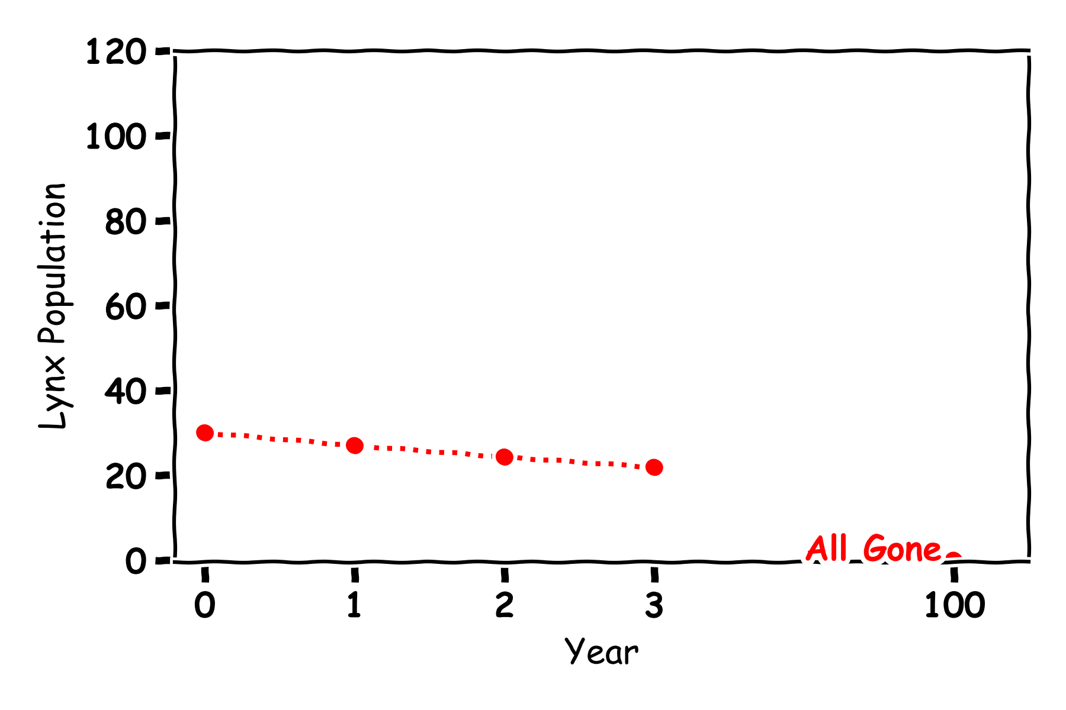
Lynx
Year | Lynx Population
0 | 30
1 | 27
2 | 24
3 | 22

Slide 26
Lynx
Year | Lynx Population
0 | 30
1 | 27
2 | 24
3 | 22

Slide 27
Lynx

Slide 28
Predator and Prey

Slide 29
Predator and Prey

Slide 30
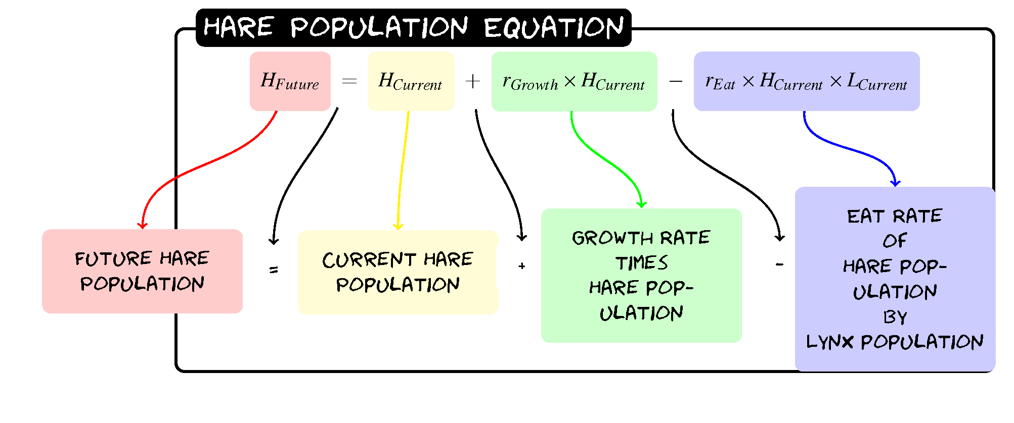
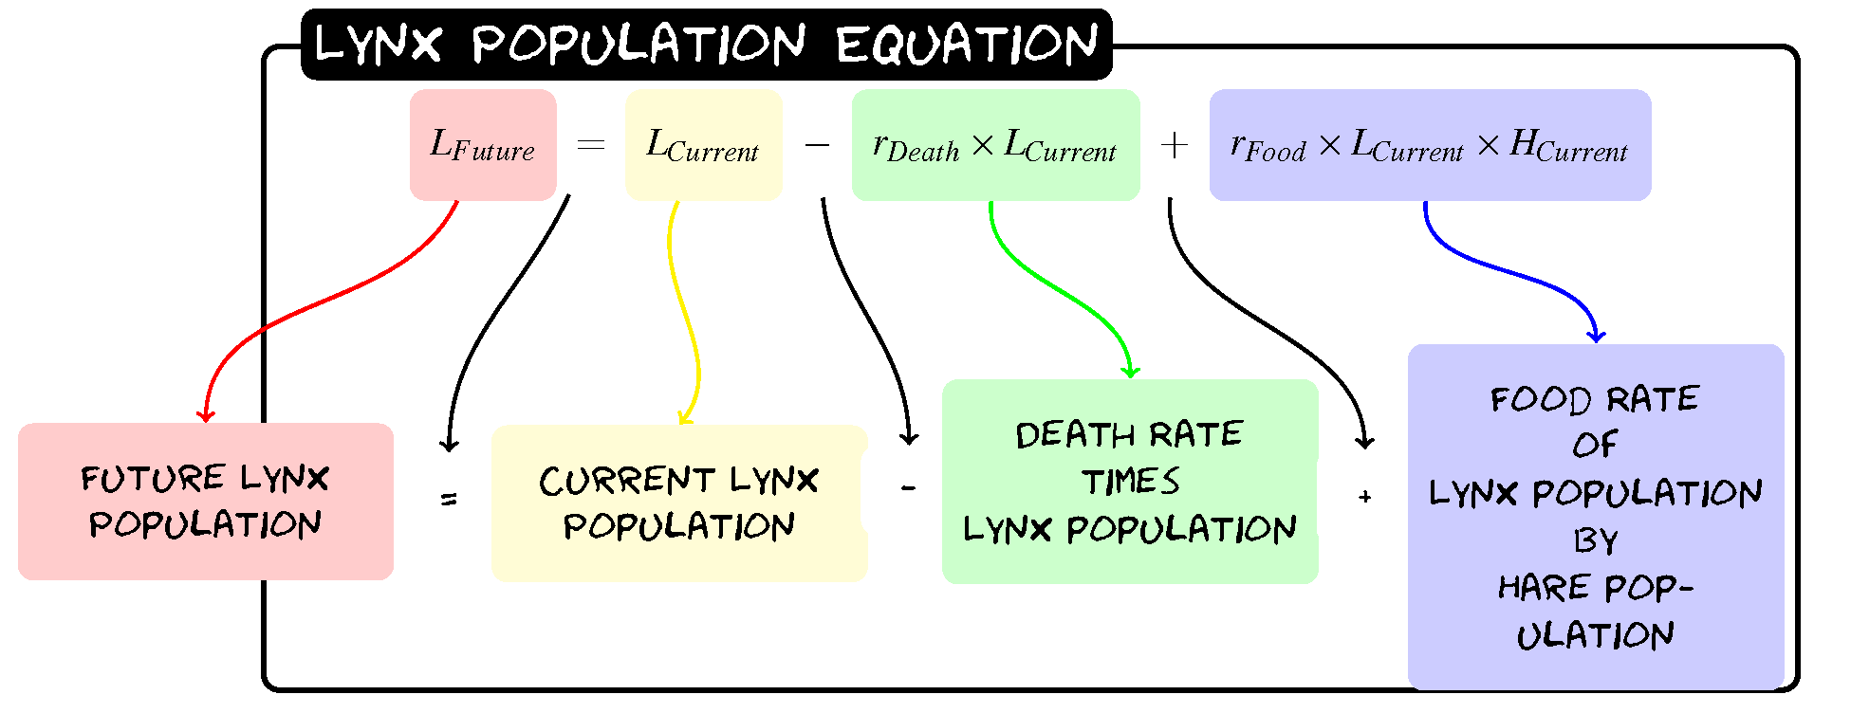
Predator and Prey

Slide 31
Predator and Prey
H_{Future}=H+0.2(H)-0.005(H)(L)
L_{Future}= L-0.1(L)+0.002(L)(H)

Slide 32
Predator and Prey
H_{Future}=H+0.2(H)-0.005(H)(L)
L_{Future}= L-0.1(L)+0.002(L)(H)
Year | Hare Population | Lynx Population
0 | 60 | 30
1
2
3

Slide 33
Predator and Prey
H_{Future}=H+0.2(H)-0.005(H)(L)
L_{Future}= L-0.1(L)+0.002(L)(H)
Year | Hare Population | Lynx Population
0 | 60 | 30
1 | 60+0.2(60)-0.005(60)(30)=63 | 30-0.1(30)+0.002(30)(60)=30.6
2
3

Slide 34
Predator and Prey
H_{Future}=H+0.2(H)-0.005(H)(L)
L_{Future}= L-0.1(L)+0.002(L)(H)
Year | Hare Population | Lynx Population
0 | 60 | 30
1 | 60+0.2(60)-0.005(60)(30)=63 | 30-0.1(30)+0.002(30)(60)=30.6
2 | 63+0.2(63)-0.005(63)(30.6)=65.9 | 30.6-0.1(30.6)+0.002(30.6)(63)=31.3
3

Slide 35
Predator and Prey
H_{Future}=H+0.2(H)-0.005(H)(L)
L_{Future}= L-0.1(L)+0.002(L)(H)
Year | Hare Population | Lynx Population
0 | 60 | 30
1 | 60+0.2(60)-0.005(60)(30)=63 | 30-0.1(30)+0.002(30)(60)=30.6
2 | 63+0.2(63)-0.005(63)(30.6)=65.9 | 30.6-0.1(30.6)+0.002(30.6)(63)=31.3
3 | 65.9+0.2(65.9)-0.005(65.9)(31.3)=68.8 | 31.3-0.1(31.3)+0.002(31.3)(65.9)=32.4

Slide 36
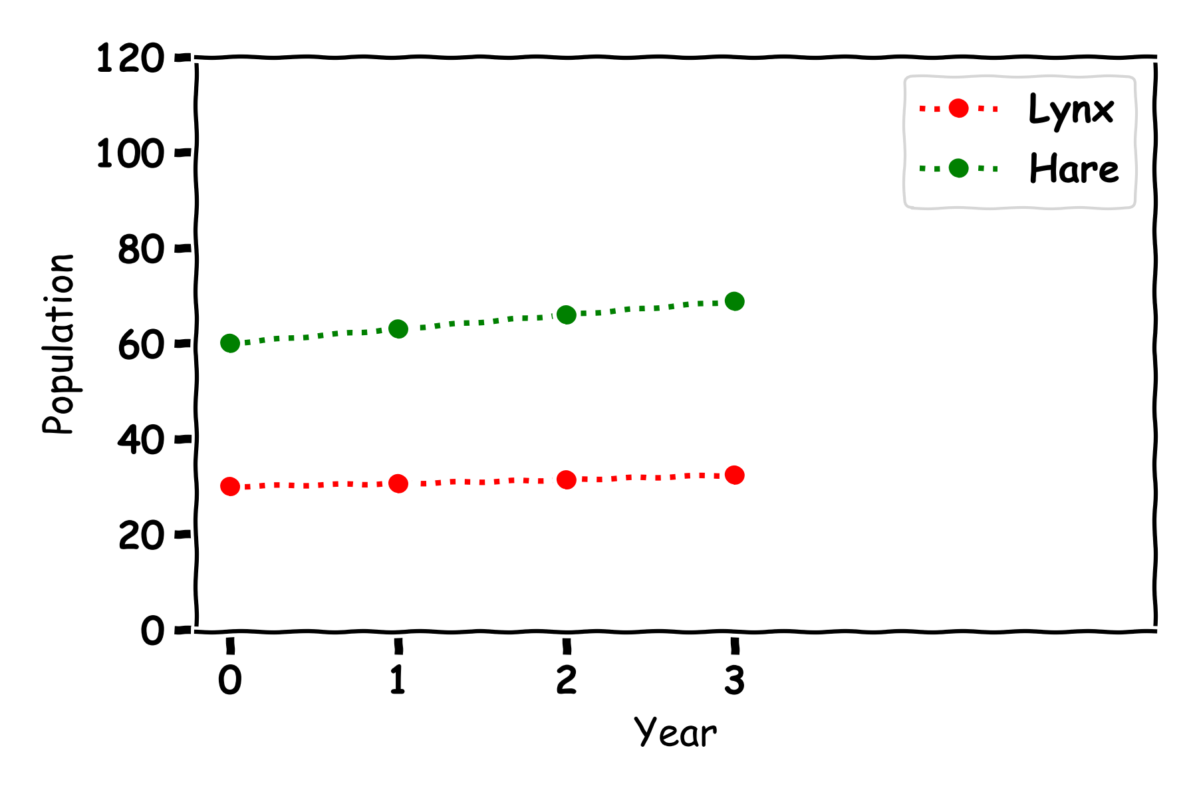
Predator and Prey
Year | Hare Population | Lynx Population
0 | 60 | 30
1 | 63 | 30.6
2 | 65.9 | 31.3
3 | 68.8 | 32.4

Slide 37
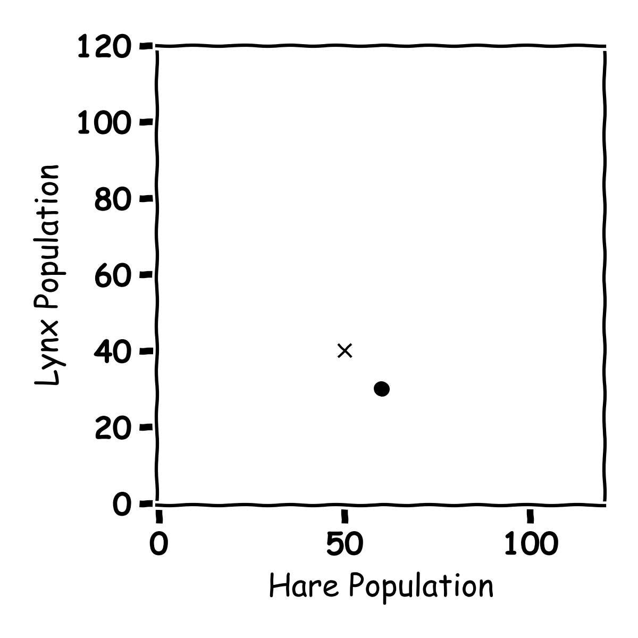
Predator and Prey
Year | Hare Population | Lynx Population
0 | 60 | 30
1
2
3

Slide 38
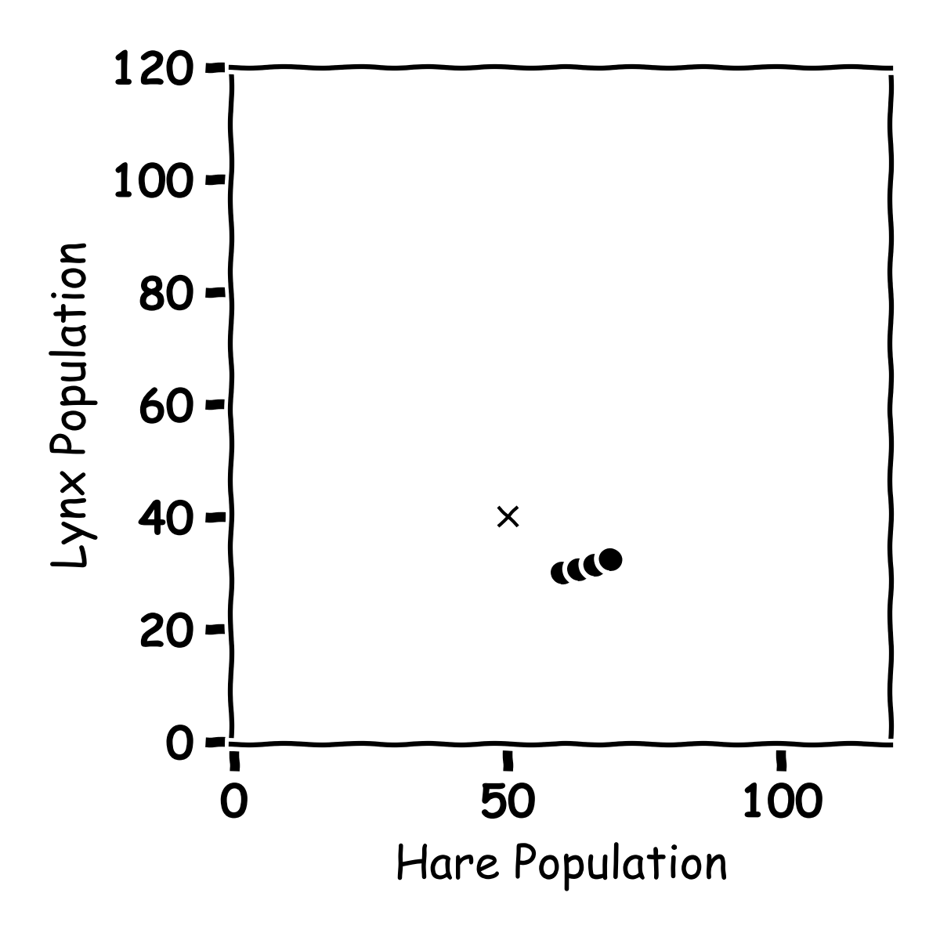
Predator and Prey
Year | Hare Population | Lynx Population
0 | 60 | 30
1 | 63 | 30.6
2 | 65.9 | 31.3
3 | 68.8 | 32.4

Slide 39
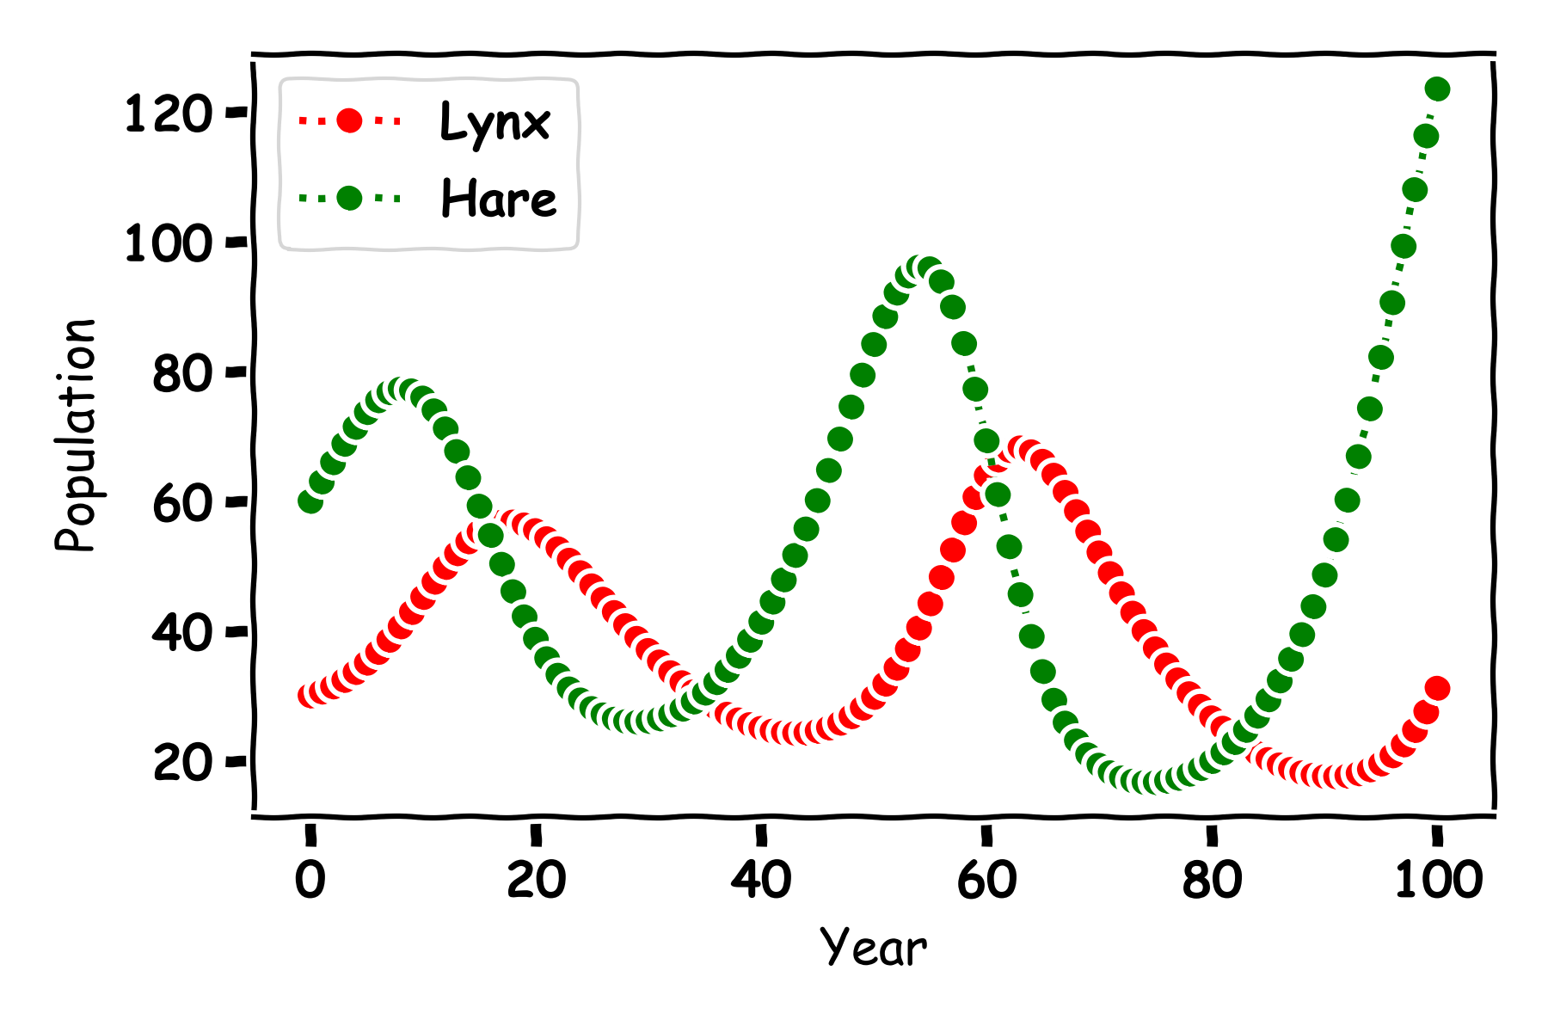
Predator and Prey

Slide 40
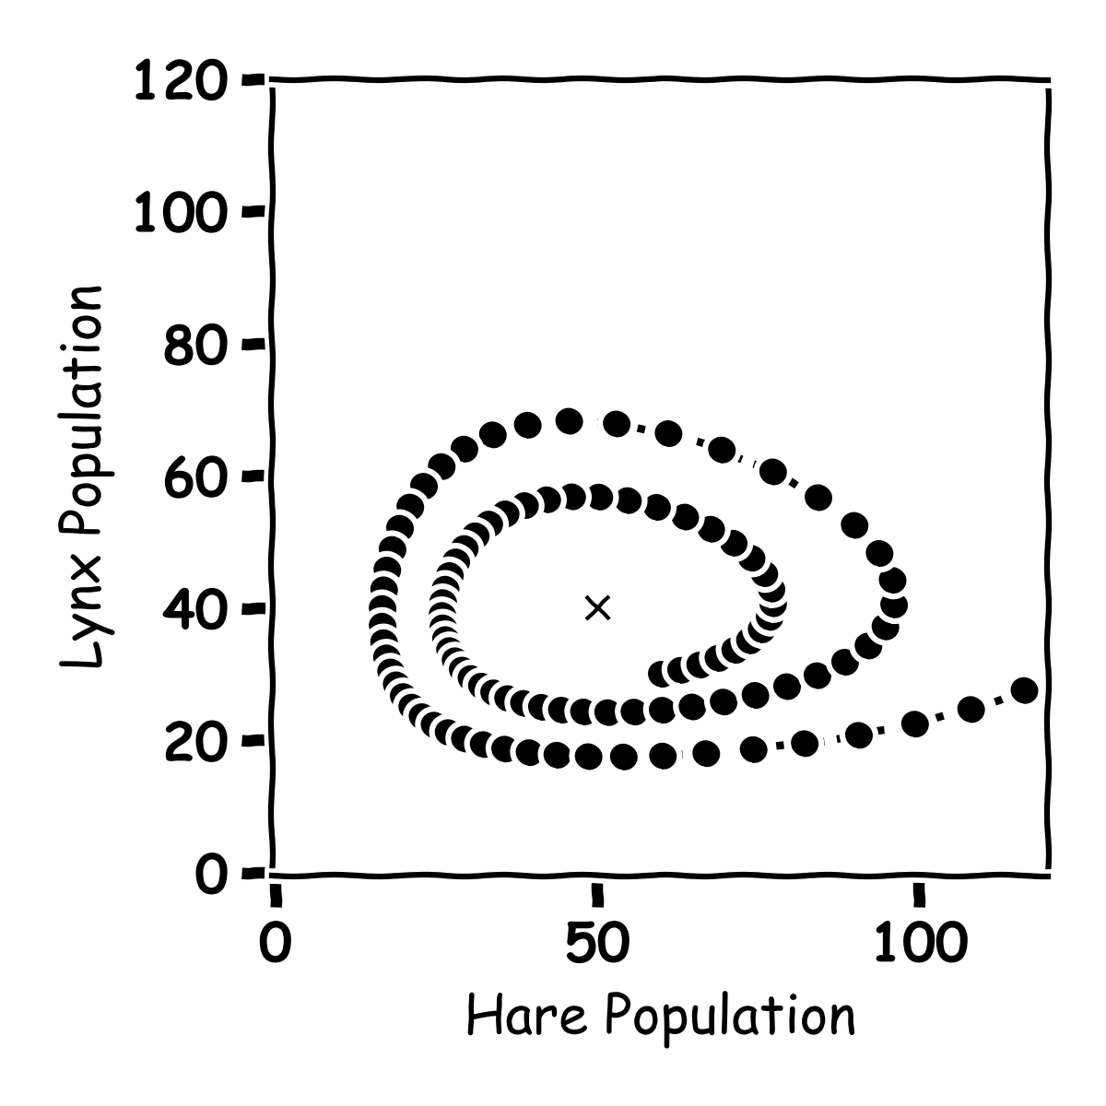
Predator and Prey

Slide 41
Predator and Prey

Slide 42
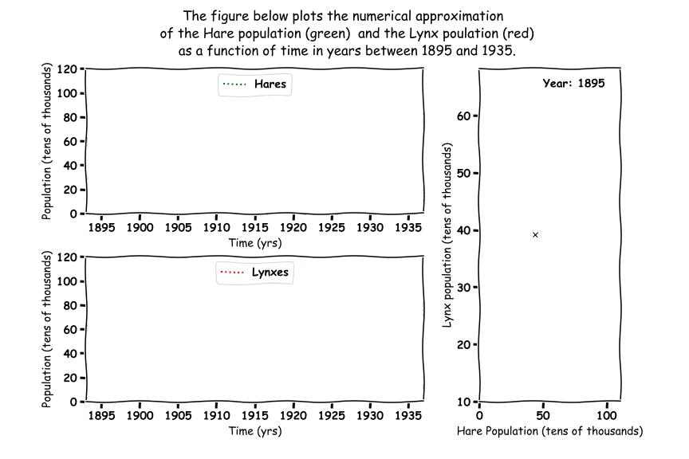
Predator and Prey

Slide 43
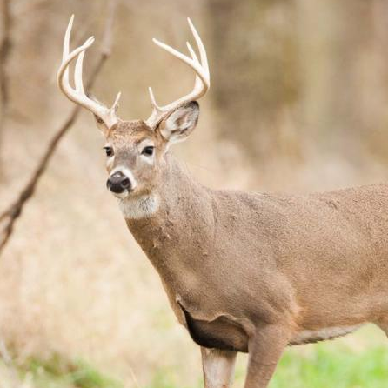
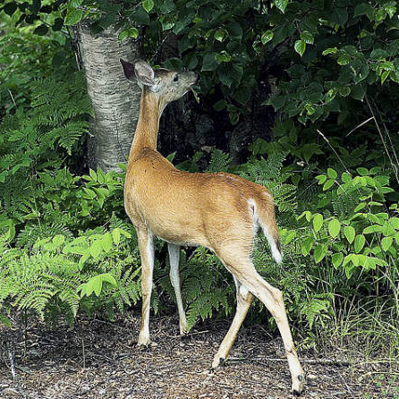
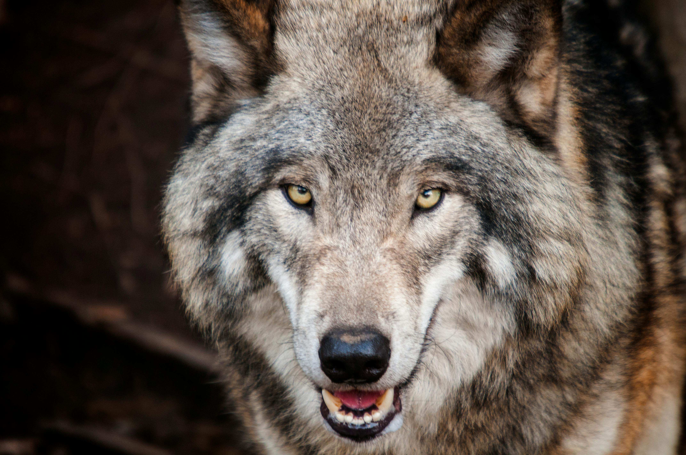
Predator Prey
Deer, Plants and Wolves

Slide 44
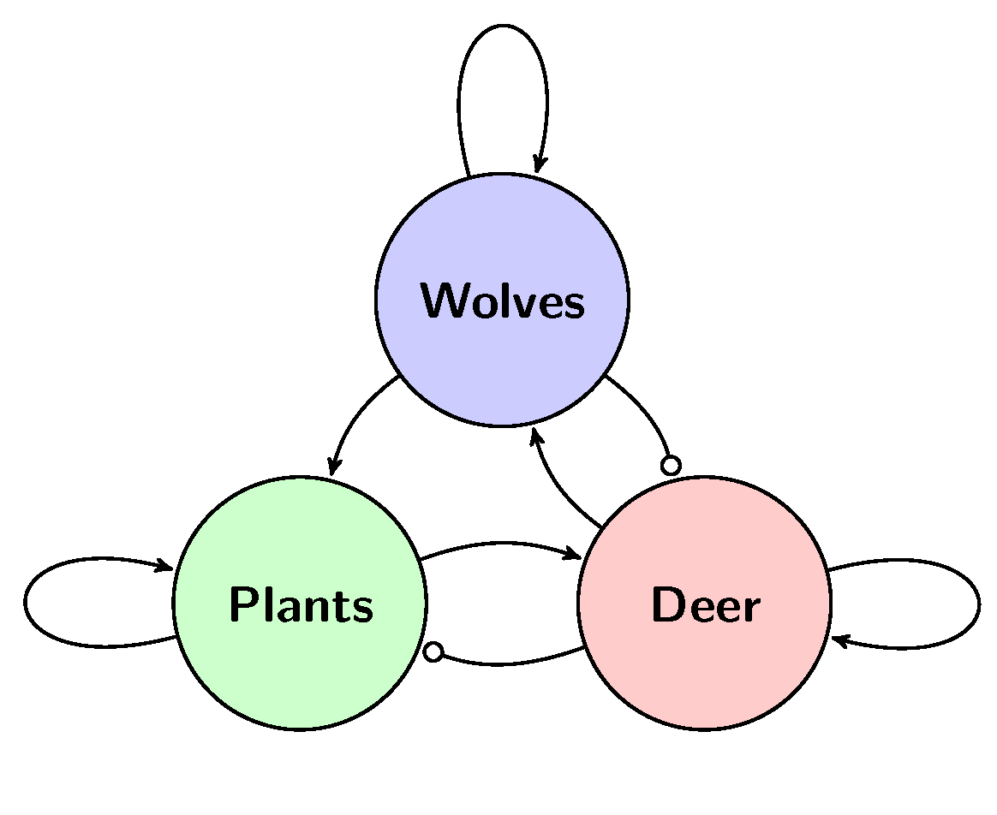
Three Animals

Slide 45
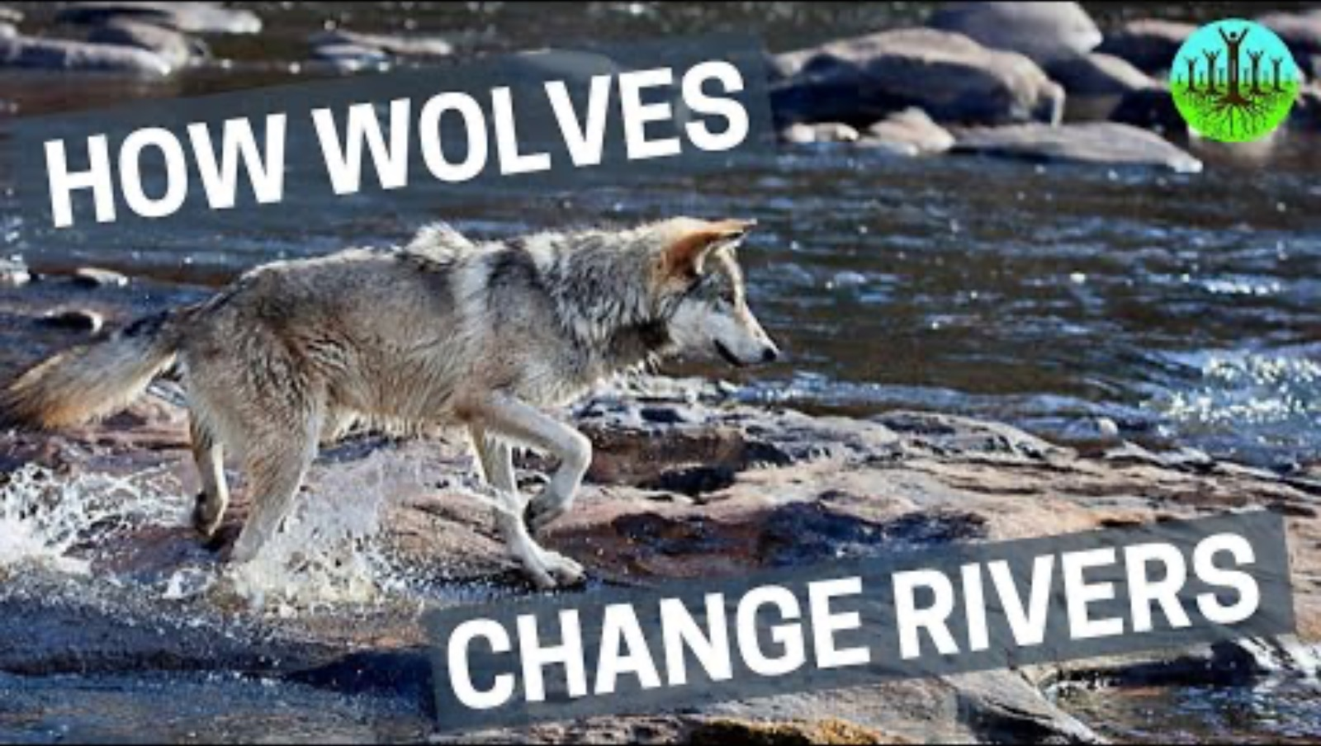
Three Animals

Slide 46
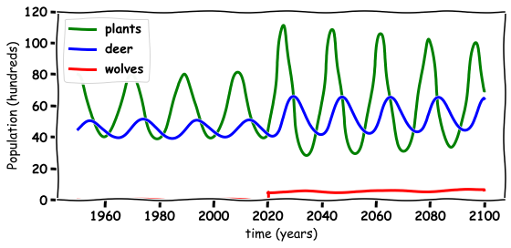
Three Animals

Slide 47
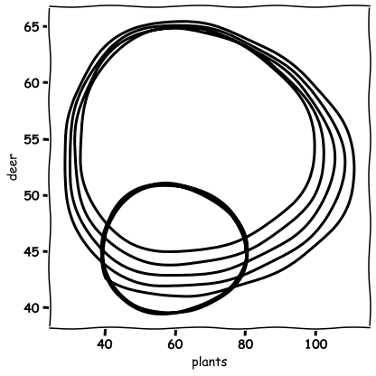
Three Animals

Slide 48

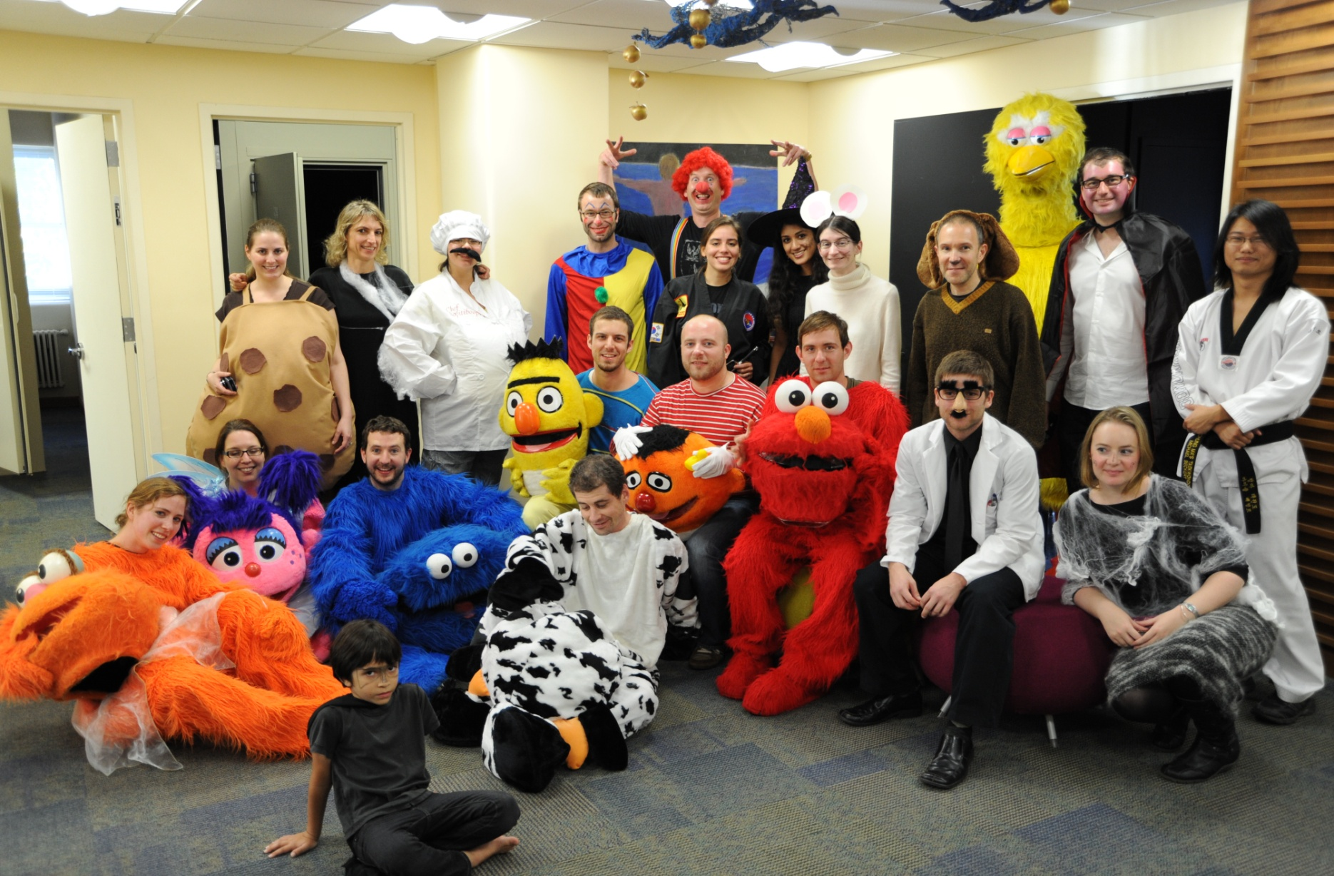
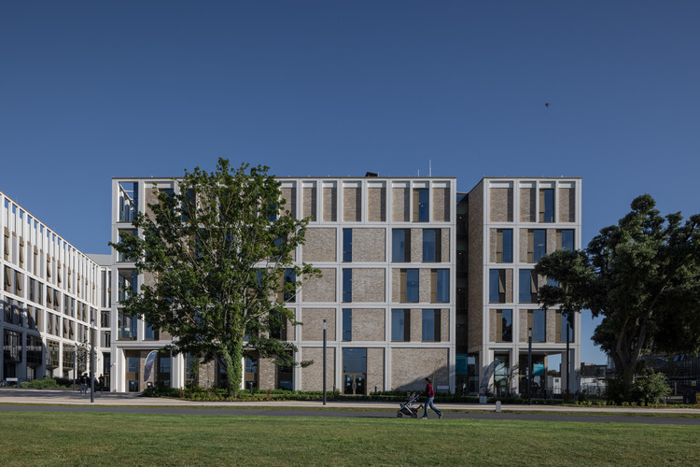
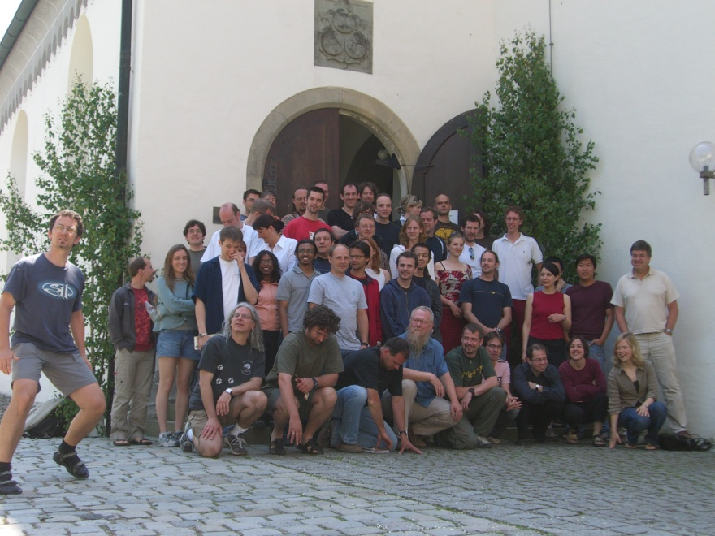
Thank you for Listening
TCD
Albert Einstein College of Medicine
TU Dublin
Max Planck Institute Germany

